Slide 1
SHOE HEAVEN
Nevena Pavlova
Yavor Karakolev
Iliya Marinov
Radoslav Ivanov

Slide 2

The main idea

Slide 3
The process
We considered the idea about our project!
We have allocated the tasks.
We have set a deadline for completing the tasks.
Final changes to the code.

Slide 4





We used:
Visual Studio 2019
Visual Studio Code
C++
GitHub

Slide 5
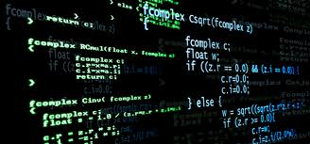
And now it's time for our program

Slide 6


Slide 7
THANK YOU FOR THE ATTENTION!

